Slide 1
Project On
Arduino RADAR Model for Distance & Angle Finding using Ultrasonic Sensor
Presented By
Afroza Akter Monisha
2018000000082
Thamina Akther
2018000000149
Submitted To
Mr. Ovishake Sen
Lecturer
Southeast University

Slide 2
Contents
Introduction
Materials
How the Materials Work
Diagrams
Construction of the System
Code
How the System Works
8. Conclusion

Slide 3
Introduction
In this project, we have designed Arduino RADAR Model using Ultrasonic Sensor for Detection & Ranging. RADAR is an object detection system that uses radio waves to identify the range, altitude, direction, and speed of the objects. The radar antenna transmits radio wave pulses that bounce off any object in its path. The object returns a portion of the wave received by the receiver which is in line of sight with the transmitter.
This Arduino RADAR project aims to achieve a radar system prototype based on an Arduino board, capable of detecting stationary and moving objects.

Slide 4
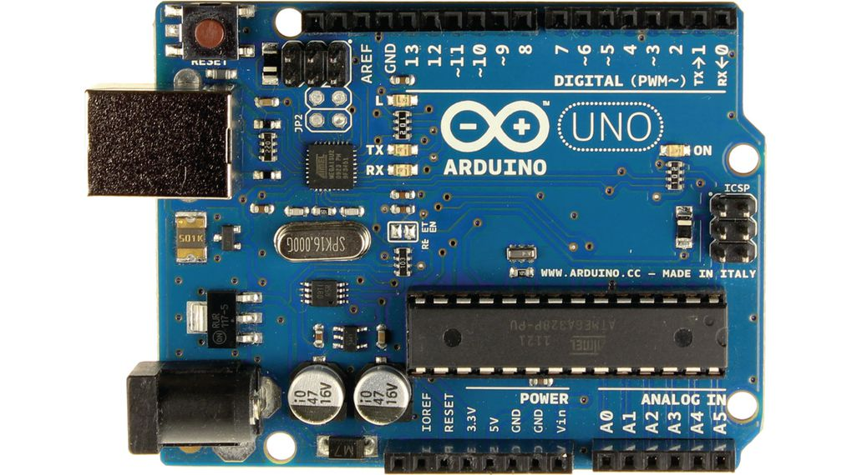
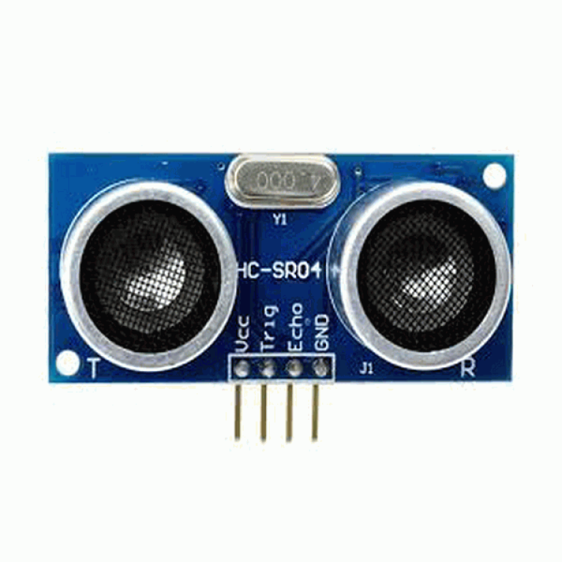
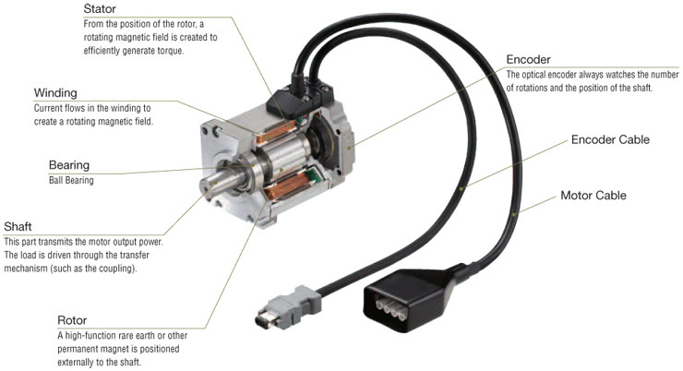
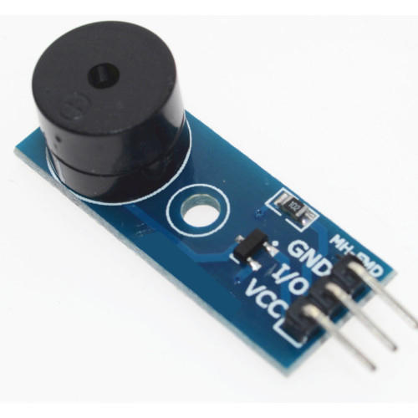
Materials
Arduino UNO
Ultrasonic Sensor
Servo Motor
Buzzer

Slide 5
Materials
More to go-
LCD Display,Potentiometer,LED,
Connecting Wires,Breadboard.

Slide 6
How The Materials Work
Introduction of Arduino uno:
Arduino can receive input signals from various sensors and inputs. By controlling light sources, motors, or other actuators, Arduino can change the surrounding environment. Arduino is able to run independently or communicate with software running on a computer . The open-source Arduino IDE, which is free to download, makes it easy for you to write code, upload it to the board and come up with your own interactive devices.
How does Arduino uno work :
The Arduino is a board based on an ATMEL AVR microcontroller. Microcontrollers are integrated circuits where instructions can be recorded , which you write with the programming language that you can use in the Arduino IDE environment. These instructions allow you to create programs that interact with the circuitry on the board.

Slide 7
Introduction of ultrasonic sensor:
An ultrasonic sensor is an electronic device that measures the distance of a target object by emitting ultrasonic sound waves, and converts the reflected sound into an electrical signal. Ultrasonic sensors have two main components: the transmitter (which emits the sound using piezoelectric crystals) and the receiver (which encounters the sound after it has traveled to and from the target).
How does work Ultrasonic Sensors Sensor:
Ultrasonic sensors are essentially sound sensors, but they operate at a frequency above human hearing.
The sensor sends out a sound wave at a specific frequency. It then listens for that specific sound wave to bounce off of an object and come back . The sensor keeps track of the time between sending the sound wave and the sound wave returning. If you know how fast something is going and how long it is traveling you can find the distance traveled with equation 1.
Equation 1. d = v × t

Slide 8
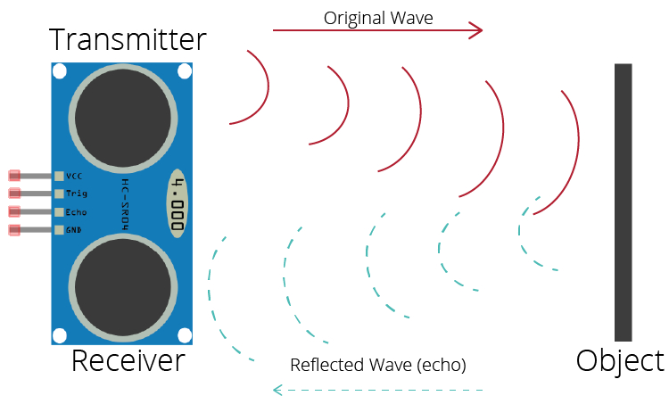
The speed of sound can be calculated based on the a variety of atmospheric
conditions, including temperature, humidity and pressure. Actually calculating the
distance will be shown later on in this document.
It should be noted that ultrasonic sensors have a cone of detection, the angle of
This cone varies with distance, The ability of a sensor to detect an object also depends on the object's orientation to the sensor. If an object doesn’t present a flat surface to the sensor then it is possible the sound wave will bounce off the object in a way that it does not return to the sensor

Slide 9
Introduction to Servo Motor
A Servo motor is a rotary actuator that allows for precise control of angular position, velocity and acceleration. Servos are found in many places, from toys to home electronics to cars and airplanes. Servos also appear behind the scenes in devices we use every day. Electronic devices such as DVD players use servos to extend or retract the disc trays.
How Servo Motor Works
Servo motors are used to control position and speed very precisely, but in a simple case, only position may be controlled. Mechanical position of the shaft can be sensed by using a potentiometer, which is coupled with the motor shaft through gears. The current position of the shaft is converted into electrical signal by the potentiometer, and the compared with the command input signal. In modern servo motors, electronic encoders or sensors are used to sense the position of the shaft.

Slide 10
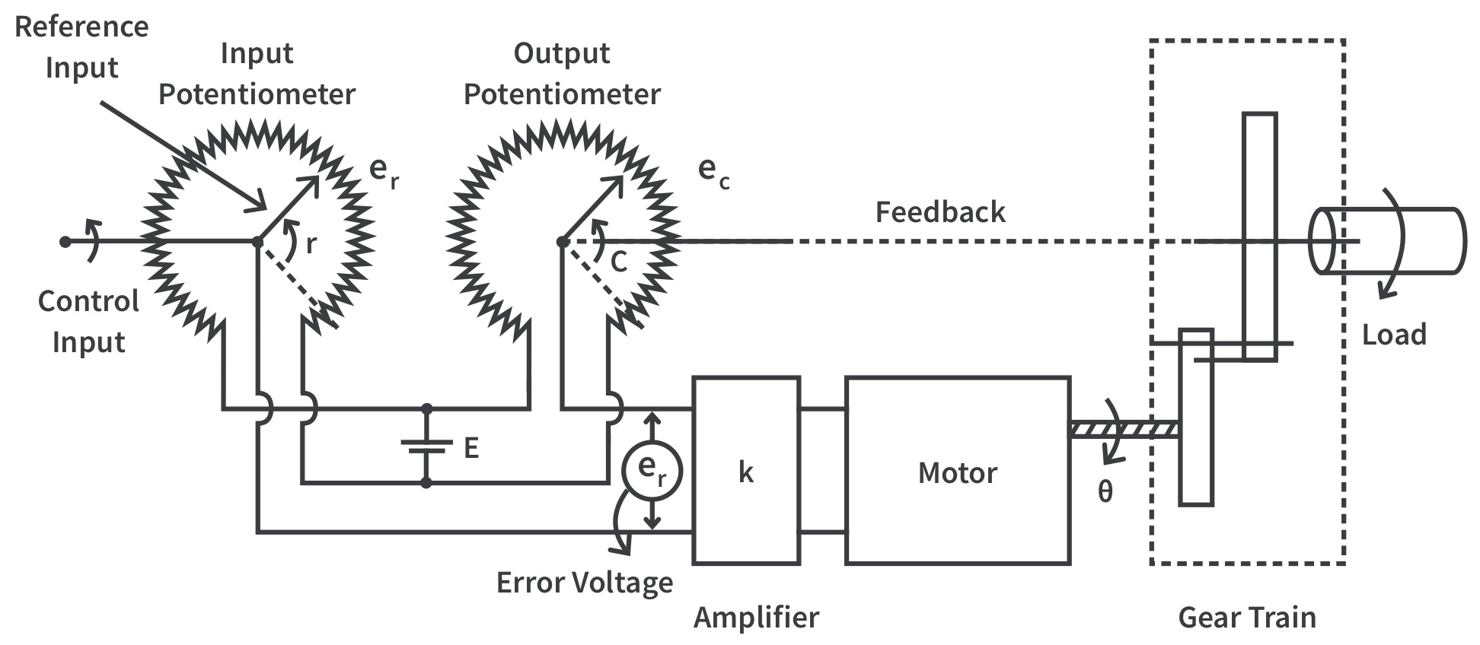
Command input is given according to the required position of the shaft. If the feedback signal differs from the given input, an error signal is generated. This error signal is then amplified and applied as the input to the motor, which causes the motor to rotate. And when the shaft reaches to the required position, error signal becomes zero, and hence the motor stays standstill holding the position

Slide 11
Introduction to Buzzer
It is an electromechanical, electromagnetic, mechanical, piezoelectric, electro-acoustic audio signaling device. This buzzer works through an audio signal source or oscillating circuit. A ring or beep or click indicates that a switch has been pushed.
How Does it Work
Magnetic buzzers operate using electromagnetic principles. When power is applied, current runs through the coil of wire inside the buzzer, which produces a magnetic field. The flexible ferromagnetic disk is attracted to the coil when the magnetic field is activated, then returns to rest when the magnetic field is off

Slide 12
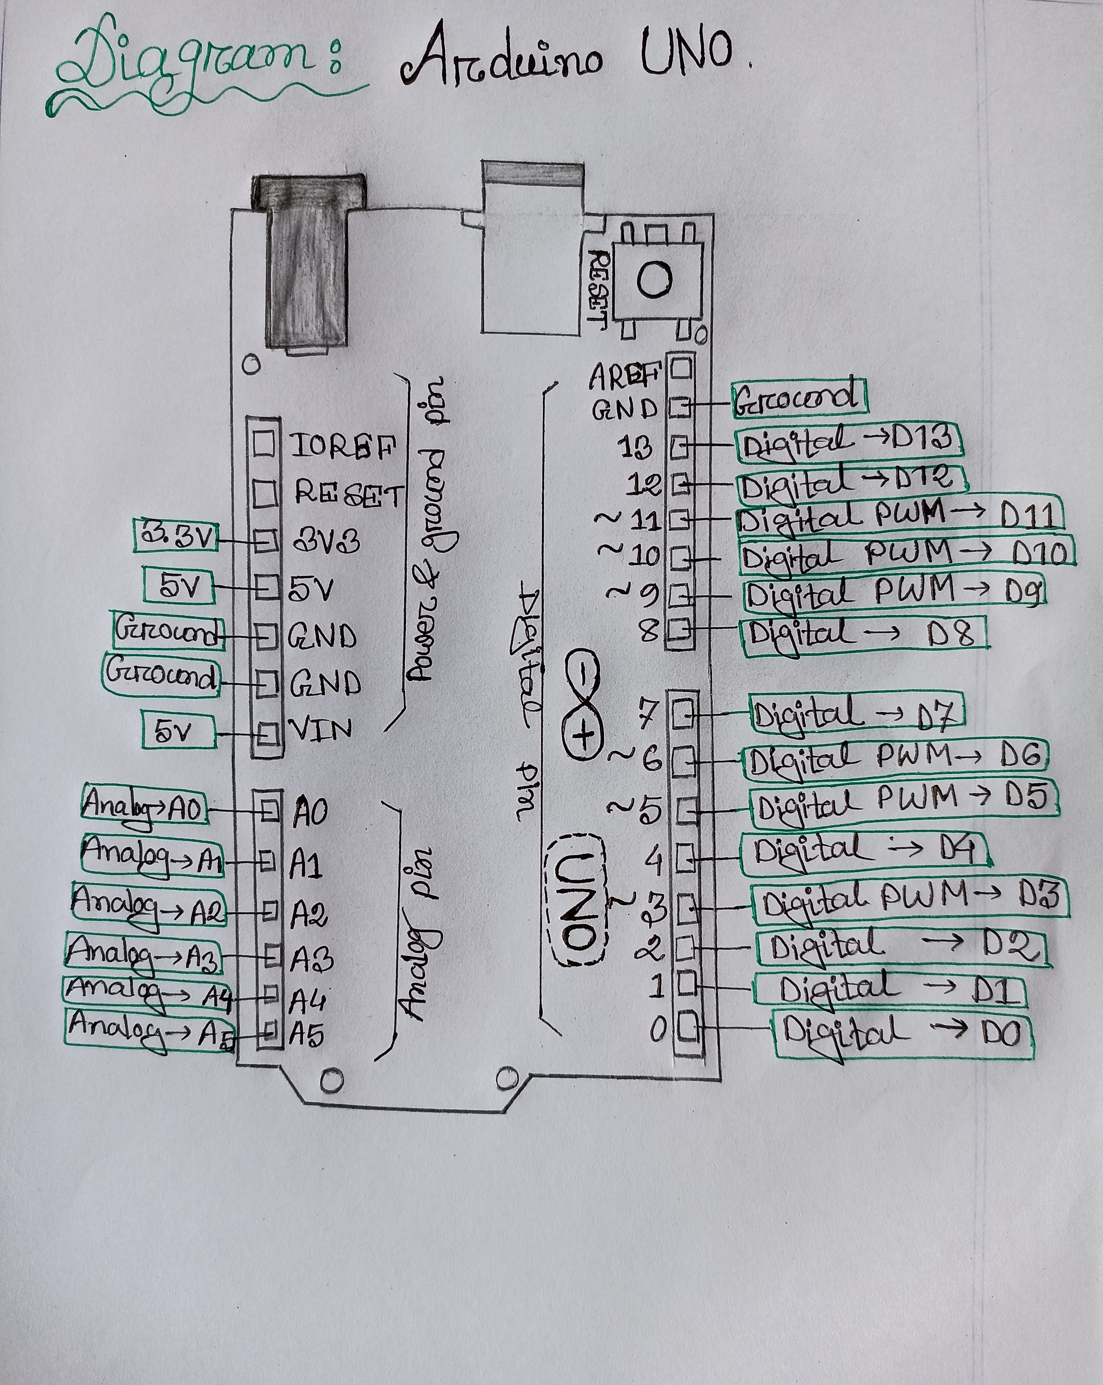
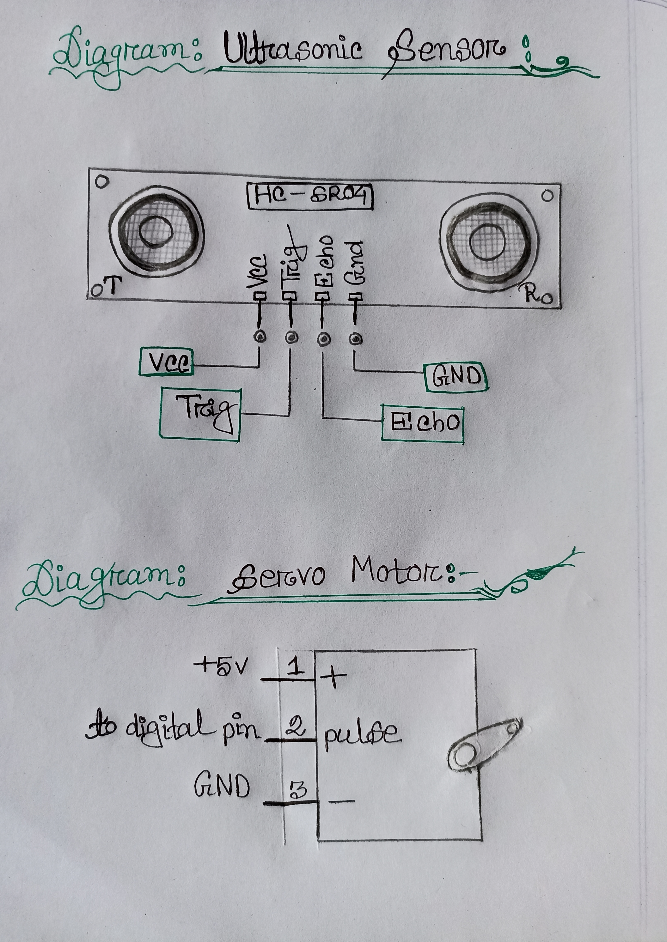
Diagrams

Slide 13
Construction of the System
First I connected the Ultrasonic sensor with the Arduino Board in the following way:-
VCC -5V
GND-GND PIN
TRIG -9
ECHO-10
Then next I connected the servo motor as follows:-
RED wire - 5V
BROWN wire- GND
ORANGE – 11
Then next I connected the buzzer to pin 12.

Slide 14
Once all the connections were done I stick the ultrasonic sensor on the servo motor with a glue gun (it doesn't stay for long but is great as a temporary solution)
Moving forward with the coding part I created a function to measure the distance from the sensor and then inside a loop I gave command to rotate the servo motor from left to right.

Slide 15
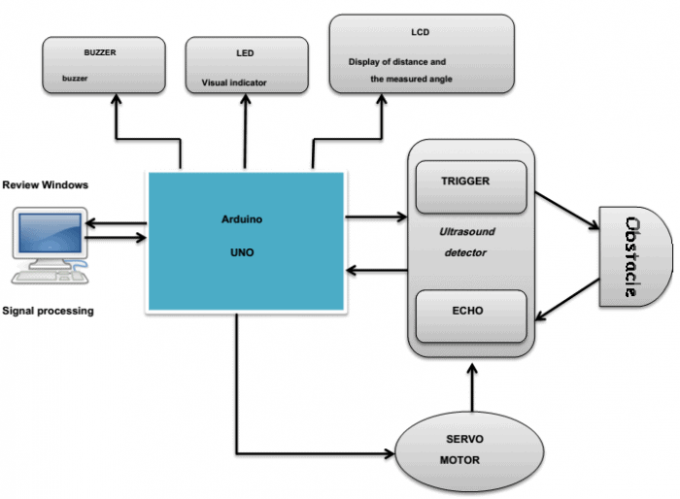
Block Diagram

Slide 16
#include <Servo.h>
#include <LiquidCrystal.h>
Servo myservo;
LiquidCrystal lcd(7, 6, 5, 4, 3, 2); // Creates an LCD object. Parameters: (rs, enable, d4, d5, d6, d7)
int pos = 0; const int trigPin = 9;
const int echoPin = 10;
const int moteur = 11;
const int buzzer = 12;
const int ledPin1 = 14;
const int ledPin2 = 15;
float distanceCm, DistanceSec,duration;
void setup() {
myservo.attach(moteur);
lcd.begin(16,2);
pinMode(trigPin, OUTPUT);
pinMode(echoPin, INPUT);
pinMode(buzzer, OUTPUT);
pinMode(ledPin1, OUTPUT);
pinMode(ledPin2, OUTPUT);
DistanceSec=20;
}

Slide 17
void loop() {
for (pos = 0; pos <= 180; pos += 1) {
myservo.write(pos);
digitalWrite(trigPin, LOW);
delayMicroseconds(2);
digitalWrite(trigPin, HIGH);
delayMicroseconds(10);
digitalWrite(trigPin, LOW);
duration = pulseIn(echoPin, HIGH);
distanceCm= duration*0.034/2;
if (distanceCm <= DistanceSec)
{
if(distanceCm <= DistanceSec/2)

Slide 18
{
tone(buzzer, 10);
digitalWrite(ledPin1, LOW);
digitalWrite(ledPin2, HIGH);
delay(700);
noTone(buzzer);
lcd.setCursor(0,0);
lcd.print("Distance: ");
lcd.print(distanceCm);
lcd.print(" cm ");
delay(10);
lcd.setCursor(0,1);
lcd.print("Angle : ");
lcd.print(pos);
lcd.print(" deg ");
delay(2000);
}
else
{
digitalWrite(buzzer, HIGH);
digitalWrite(ledPin2, LOW);
digitalWrite(ledPin1, HIGH);
delay(100);
digitalWrite(buzzer, LOW);
lcd.setCursor(0,0);
lcd.print("Distance: ");
lcd.print(distanceCm);
lcd.print(" cm ");
delay(10);
lcd.setCursor(0,1);
lcd.print("Angle : ");
lcd.print(pos);
lcd.print(" deg ");
delay(2000);
}
}
else{
digitalWrite(buzzer, LOW);
digitalWrite(ledPin1, LOW);
digitalWrite(ledPin2, LOW);
}

Slide 19
lcd.setCursor(0,0);
lcd.print("Distance: ");
lcd.print(distanceCm);
lcd.print(" cm ");
delay(10);
lcd.setCursor(0,1);
lcd.print("Angle : ");
lcd.print(pos);
lcd.print(" deg ");
delay(80);
}
for (pos = 180; pos >= 0; pos -= 1)
digitalWrite(trigPin, LOW);
delayMicroseconds(2);
digitalWrite(trigPin, HIGH);
delayMicroseconds(10);
digitalWrite(trigPin, LOW);
duration = pulseIn(echoPin, HIGH);
distanceCm= duration*0.034/2;
if (distanceCm <= DistanceSec){
if(distanceCm <= DistanceSec/2

Slide 20
lcd.setCursor(0,0);
lcd.print("Distance: ");
lcd.print(distanceCm);
lcd.print(" cm ");
delay(10);
lcd.setCursor(0,1);
lcd.print("Angle : ");
lcd.print(pos);
lcd.print(" deg ");
delay(2000);
}
}
else{
digitalWrite(buzzer, LOW);
digitalWrite(ledPin1, LOW);
digitalWrite(ledPin2, LOW);
}
lcd.setCursor(0,0);
lcd.print("Distance: ");
lcd.print(distanceCm);
lcd.print(" cm ");
delay(10);
lcd.setCursor(0,1);
lcd.print("Angle : ");
lcd.print(pos);
lcd.print(" deg ");
delay(80);
}
}
{
tone(buzzer, 10);
digitalWrite(ledPin1, LOW);
digitalWrite(ledPin2, HIGH);
delay(700);
noTone(buzzer);
lcd.setCursor(0,0);
lcd.print("Distance: ");
lcd.print(distanceCm);
lcd.print(" cm ");
delay(10);
lcd.setCursor(0,1);
lcd.print("Angle : ");
lcd.print(pos);
lcd.print(" deg ");
delay(2000);
}
else
{
digitalWrite(buzzer, HIGH);
digitalWrite(ledPin2, LOW);
digitalWrite(ledPin1, HIGH);
delay(100);
digitalWrite(buzzer, LOW);

Slide 21
How the System Works
Arduino board sends a signal of +5V to the trig pin of Ultrasonic Sensor HC-SR04 which triggers the sensor. Then it provides rotational action at the servo motor mechanically fitted along with ultrasonic Sensor HC-SR04 so that it can detect the moving objects and locate within 180 degrees.

Slide 22
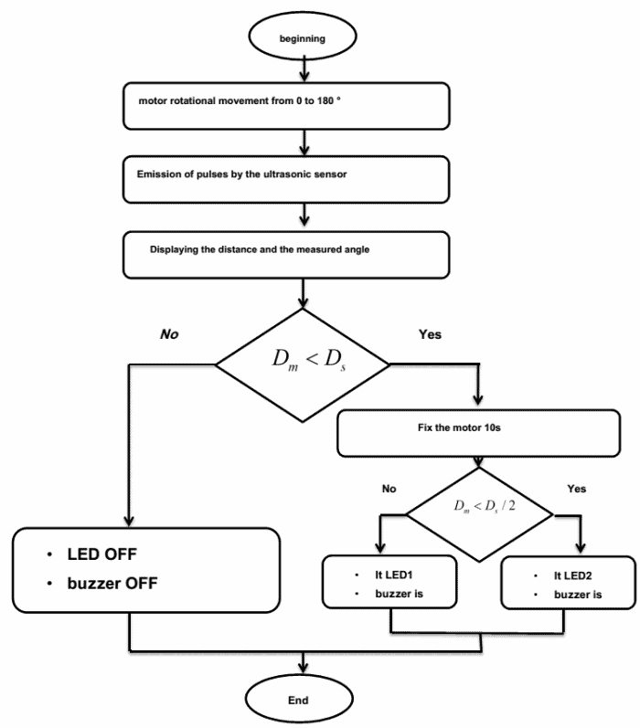

Slide 23
The Arduino sends a HIGH pulse width of (10 S) on the TRIGGER pin of the sensor to regenerate a series of ultrasonic waves that propagate through the air until it touches an obstacle and returns in the opposite direction towards the sensor pin ECHO. The sensor detects the width of the pulse to calculate the distance. The signal on pin ECHO the sensor remains at the HIGH position during transmission, thereby measuring the duration of the round trip of ultrasound and thus determine the distance.
The LCD display displays the calculated distance and the angle of rotation. The buzzer is an additional component, it rings when there is a detection (Tone1 and Tone2) along with LEDs. Both LEDs along with the buzzer determine the field where the object is located (near or distant).

Slide 24
Conclusion
It detects the object by transmitting ultrasonic waves and converts the reflected waves into an electrical signal. These sound waves travel faster than the speed of the sound that humans can hear. It has two main components: the transmitter & receiver.
It used in Army boats and fighting Planes.Also used for air-traffic control at airports, and long range surveillance and early-warning systems.

Slide 25
Thank You !

